Slide 1
Informed search algorithms
one that uses problem-specific knowledge
beyond the definition of the problem itself can find solutions more efficiently than can
an uninformed strategy.

Slide 2
Outline
Best-first search
Greedy best-first search
A* search
Heuristics
Local search algorithms
Hill-climbing search
Simulated annealing search
Local beam search
Genetic algorithms

Slide 3
Best-first search
The general approach we will consider is called best-first search.
Best-first search is an instance of the general TREE-SEARCH or GRAPH-SEARCH algorithm in which a node is selected for expansion based on an evaluation function, f (n) .

Slide 4
Best-first search
Idea: use an evaluation function f(n) for each node
  f(n) provides an estimate for the total cost.
  Expand the node n with smallest f(n).
  f (n) = h(n).
Implementation:
Order the nodes in fringe increasing order of cost.
Special cases:
  greedy best-first search
  A* search

Slide 5

Romania with straight-line dist.

Slide 6
Greedy best-first search
f(n) = estimate of cost from n to goal
e.g., f(n) = straight-line distance from n to Bucharest
Greedy best-first search expands the node that appears to be closest to goal.

Slide 7

Greedy best-first search example

Slide 8

Greedy best-first search example

Slide 9

Greedy best-first search example

Slide 10

Greedy best-first search example

Slide 11
Properties of greedy best-first search
Think of an example
Complete? No – can get stuck in loops.
Iasi to Fagaras
Neamt- dead end
Soln: Iasi -Vaslui-Urziceni- Bucharest-Fagaras.
Time? O(b^{m}), but a good heuristic can give dramatic improvement
Space? O(b^{m}) - keeps all nodes in memory
Optimal? No
e.g. Arad→Sibiu→Rimnicu Virea→Pitesti→Bucharest is shorter!

Slide 12
A* search: Minimizing the total estimated solution cost
Idea: avoid expanding paths that are already expanded
Evaluation function f(n) = g(n) + h(n)
g(n) = path cost from start node to reach node n
h(n) = estimated cost of the cheapest soln. through n
f(n) = estimated total cost (cheapest) of path through n to goal
Best First search has f(n)=h(n)
Uniform Cost search has f(n)=g(n)
if n is a goal node, then h(n) = 0.

Slide 13
Conditions for optimality: Admissibility and consistency
The first condition we require for optimality is that h(n) be an admissible heuristic.
A second, slightly stronger condition called consistency (or sometimes monotonicity) is required only for applications of A∗ to graph search

Slide 14
Admissible heuristics
A heuristic h(n) is admissible if for every node n,
h(n) ≤ h*(n), where h*(n) is the true cost to reach the goal state from n.
An admissible heuristic never overestimates the cost to reach the goal, i.e., it is optimistic
Example: h_{SLD}(n) (never overestimates the actual road distance)
Theorem: If h(n) is admissible, A* using TREE-SEARCH is optimal

Slide 15

A* search example

Slide 16

A* search example

Slide 17

A* search example

Slide 18

A* search example

Slide 19

A* search example

Slide 20

A* search example

Slide 21
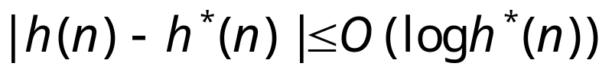
Properties of A*
Complete? A* using TREE-SEARCH is optimal if h(n) is admissible. (bucharest values>Pitesti values)
Time/Space? Exponential
except if:
Optimal? A* using TREE-SEARCH is optimal if h(n) is admissible
Optimally Efficient: Yes (no algorithm with the
same heuristic is guaranteed to expand fewer nodes)

Slide 22

Optimality of A* (proof)
Suppose some suboptimal goal G₂ has been generated and is in the fringe. Let n be an unexpanded node in the fringe such that n is on a shortest path to an optimal goal G.
let the cost of the optimal solution be C*.
f (G2) = g(G2) + h(G2) = g(G2) > C* .
because G2 is suboptimal and because h(G2)=0
(true for any goal node),
f (n) = g(n) + h(n) <= C* .
f(n) <=C* < f (G2) s,o G2 will not be expanded and A* must
return an optimal solution.
We want to prove:
f(n) < f(G2)
(then A* will prefer n over G2)

Slide 23
Graph Search
If we use the GRAPH-SEARCH algorithm instead of TREE-SEARCH, then this proof breaks down.
Suboptimal solutions can be returned because GRAPH-SEARCH can discard the optimal path to a repeated state if it is not the first one generated.

Slide 24
two ways to fix this problem
The first solution is to extend GRAPH-SEARCH so that it discards the more expensive of any two paths found to the same node.
The extra bookkeeping is messy, but it does guarantee optimality.

Slide 25
two ways to fix this problem
The second solution is to ensure that the optimal path to any repeated state is always the first one followed-as is the case with uniform-cost search.
This property holds if we impose an extra requirement on h(n),namely the requirement of consistency (also called monotonicity).

Slide 26

Consistent heuristics
A heuristic is consistent if for every node n, every successor n' of n generated by any action a, the estimated cost of reaching the goal from n is no greater than the step cost of getting to n
plus the estimated cost of reaching the goal from n :
h(n) ≤ c(n,a,n') + h(n')
each side of a triangle cannot be longer than the sum of the other two sides.
For an admissible heuristic, the inequality makes perfect sense: if there were a route from n to Gn via n that was cheaper than h(n), that would violate the property that h(n) is a lower bound on the cost to reach Gn.
It’s the triangle
inequality !
A* using GRAPH-SEARCH is optimal if h(n) is consistent.

Slide 27

Optimality of A*
A* expands nodes in order of increasing f value
Gradually adds "f-contours" of nodes
Contour i contains all nodes with f≤f_{i} where f_{i} < f_{i+1}

Slide 28
straight-line distances
A
6
D
1
F
3
1
h(S-G)=10
h(A-G)=7
h(D-G)=1
h(F-G)=1
h(B-G)=10
h(E-G)=8
h(C-G)=20
S
2
4
8
G
B
E
1
20
C
try yourself
The graph above shows the step-costs for different paths going from the start (S) to
the goal (G). On the right you find the straight-line distances.
Draw the search tree for this problem. Avoid repeated states.
Give the order in which the tree is searched (e.g. S-C-B...-G) for A* search.
Use the straight-line dist. as a heuristic function, i.e. h=SLD,
and indicate for each node visited what the value for the evaluation function, f, is.

Slide 29
Memory Bounded Heuristic Search: Recursive BFS
How can we solve the memory problem for A* search?
Idea: Try something like depth first search, but let’s not forget everything about the branches we have partially explored.
We remember the best f-value we have found so far in the branch we are deleting.

Slide 30
Memory Bounded Heuristic Search
The main difference between IDA* and standard iterative deepening is that the cutoff used is the f -cost (g + h) rather than the depth; at each iteration, the cutoff value is the smallest f -cost of any node that exceeded the cutoff on the previous iteration.

Slide 31
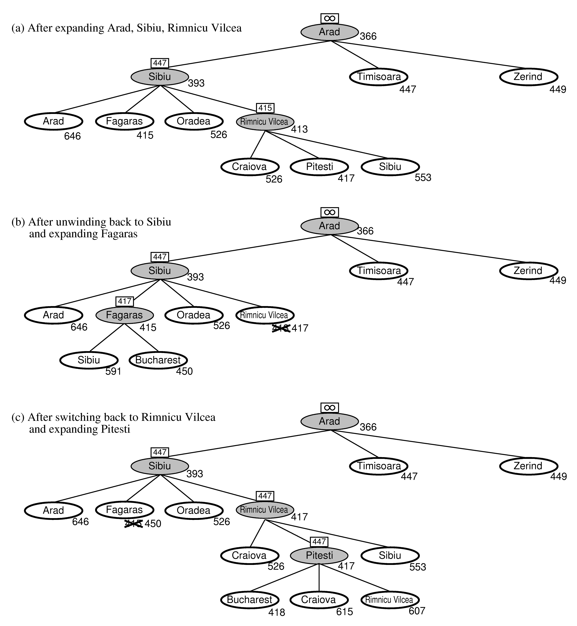
RBFS:
best alternative
over fringe nodes,
which are not children:
do I want to back up?
RBFS changes its mind
very often in practice.
This is because the
f=g+h become more
accurate (less optimistic)
as we approach the goal.
Hence, higher level nodes
have smaller f-values and
will be explored first.
Problem: We should keep
in memory whatever we can.

Slide 32
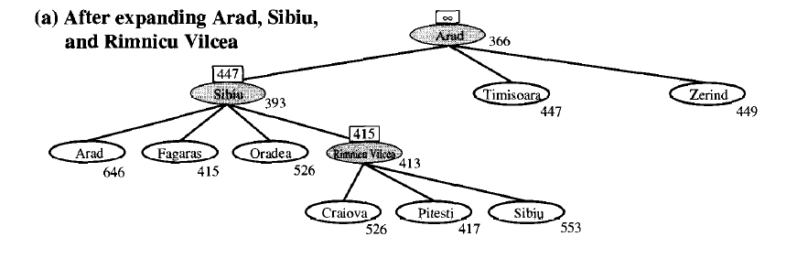

Slide 33
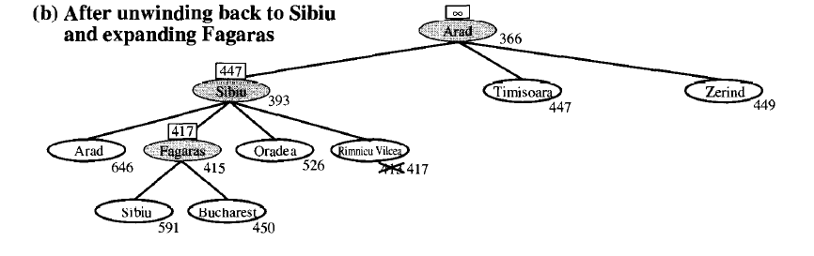

Slide 34
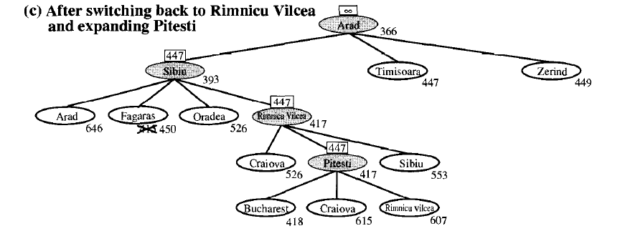

Slide 35
Simple Memory Bounded A*
This is like A*, but when memory is full we delete the worst node (largest f-value).
Like RBFS, we remember the best descendent in the branch we delete.
If there is a tie (equal f-values) we delete the oldest nodes first.
simple-MBA* finds the optimal reachable solution given the memory constraint.
Time can still be exponential.
A Solution is not reachable
if a single path from root to goal
does not fit into memory

Slide 36
Admissible heuristics
h1 = the number of misplaced tiles. start state would have h1 = 8. h1 is an admissible heuristic because it is clear that any tile that is out of place must be moved at least once.
h2 = the sum of the distances of the tiles from their goal positions. Because tiles cannot move along diagonals, the distance we will count is the sum of the horizontal and vertical distances.

Slide 37

Admissible heuristics
E.g., for the 8-puzzle:
h₁(n) = number of misplaced tiles
h₂(n) = total Manhattan distance
(i.e., no. of squares from desired location of each tile)
h₁(S) = ?
h₂(S) = ?

Slide 38
Admissible heuristics
E.g., for the 8-puzzle:
h₁(n) = number of misplaced tiles
h₂(n) = total Manhattan distance
(i.e., no. of squares from desired location of each tile)
h₁(S) = ? 8
h₂(S) = ? 3+1+2+2+2+3+3+2 = 18

Slide 39
Dominance
If h₂(n) ≥ h₁(n) for all n (both admissible)
then h₂ dominates h₁
h₂ is better for search: it is guaranteed to expand
less or equal nr of nodes.
Typical search costs (average number of nodes expanded):
d=12 IDS = 3,644,035 nodes
A*(h₁) = 227 nodes
A*(h₂) = 73 nodes
d=24 IDS = too many nodes
A*(h₁) = 39,135 nodes
A*(h₂) = 1,641 nodes

Slide 40
Relaxed problems
A problem with fewer restrictions on the actions is called a relaxed problem
The cost of an optimal solution to a relaxed problem is an admissible heuristic for the original problem
If the rules of the 8-puzzle are relaxed so that a tile can move anywhere, then h₁(n) gives the shortest solution
If the rules are relaxed so that a tile can move to any adjacent square, then h₂(n) gives the shortest solution

Slide 41
Local search algorithms
In many optimization problems, the path to the goal is irrelevant; the goal state itself is the solution
State space = set of "complete" configurations
Find configuration satisfying constraints, e.g., n-queens
In such cases, we can use local search algorithms
keep a single "current" state, try to improve it.
Very memory efficient (only remember current state)

Slide 42

Example: n-queens
Put n queens on an n × n board with no two queens on the same row, column, or diagonal
Note that a state cannot be an incomplete configuration with m<n queens

Slide 43

Hill-climbing search
Problem: depending on initial state, can get stuck in local maxima

Slide 44
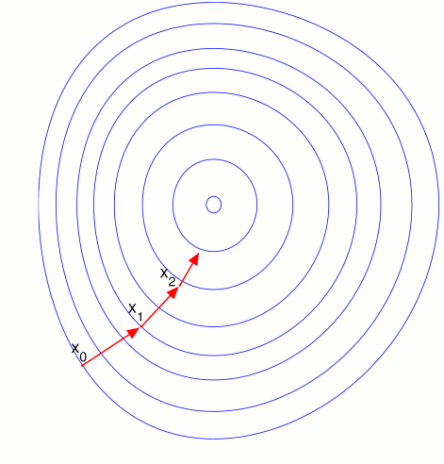

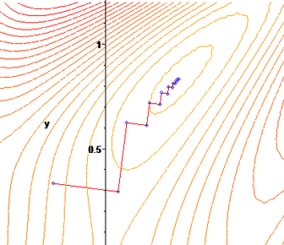
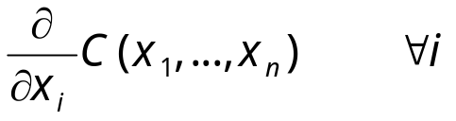
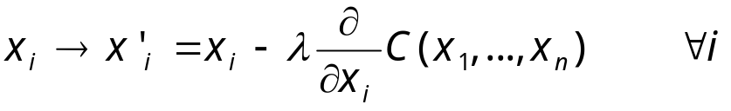
Gradient Descent
Assume we have some cost-function:
and we want minimize over continuous variables X1,X2,..,Xn
1. Compute the gradient :
2. Take a small step downhill in the direction of the gradient:
3. Check if
4. If true then accept move, if not reject.
5. Repeat.

Slide 45
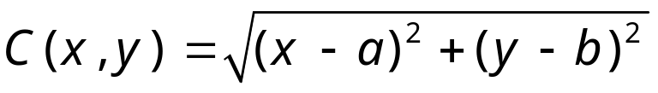
Exercise
Describe the gradient descent algorithm for the cost function:

Slide 46

Hill-climbing search: 8-queens problem
Each number indicates h if we move
a queen in its corresponding column
h = number of pairs of queens that are attacking each other, either directly or indirectly (h = 17 for the above state)

Slide 47

Hill-climbing search: 8-queens problem
A local minimum with h = 1
what can you do to get out of this local minima?)

Slide 48
Simulated annealing search
Idea: escape local maxima by allowing some "bad" moves but gradually decrease their frequency.
This is like smoothing the cost landscape.

Slide 49
Properties of simulated annealing search
One can prove: If T decreases slowly enough, then simulated annealing search will find a global optimum with probability approaching 1 (however, this may take VERY long)
Widely used in VLSI layout, airline scheduling, etc.

Slide 50
Local beam search
Keep track of k states rather than just one.
Start with k randomly generated states.
At each iteration, all the successors of all k states are generated.
If any one is a goal state, stop; else select the k best successors from the complete list and repeat.

Slide 51
Genetic algorithms
A successor state is generated by combining two parent states
Start with k randomly generated states (population)
A state is represented as a string over a finite alphabet (often a string of 0s and 1s)
Evaluation function (fitness function). Higher values for better states.
Produce the next generation of states by selection, crossover, and mutation

Slide 52


Fitness function: number of non-attacking pairs of queens (min = 0, max = 8 × 7/2 = 28)
P(child) = 24/(24+23+20+11) = 31%
P(child) = 23/(24+23+20+11) = 29% etc
fitness:
#non-attacking queens
probability of being
regenerated
in next generation

Slide 53
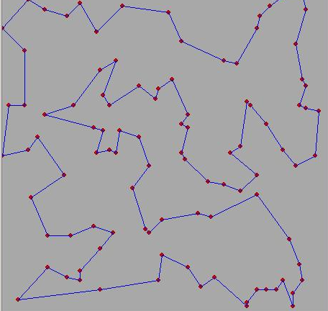
Exercise
Traveling salesman problem.
Given N cities and all their distances, find the shortest tour through all cities.
1. Define representation (genes)
2. Define cross-over (create valid paths)
3. Define mutation
4. Define fitness
5. How do we choose children?
DEMO:
http://www-cse.uta.edu/~cook/ai1/lectures/applets/gatsp/TSP.html

Slide 54
Project
Implement a genetic algorithm to solve the following problem:
Consider filling a MxN rectangle with the numbers 1...MN
Each number has either 4 neighbors or 3 neighbors
(on the edge) or 2 neighbors (in a corner).
The total cost is the of all the absolute differences
between all neighboring pairs of numbers.
We’ll give you a big problem after some deadline and you then
have a couple of days to find the best solution you can find.
The lowest cost solution wins.
If you come up with a fancy alternative to GA you may request
to implement that as an alternative to solve the same problem.
1
2
3
4
5
6
7
8
9
10
11
12
cost = |1-2|+|2-3|+|3-4|+|5-6|+|6-7|+|7-8|+|9-10|+|10-11|+|11-12|
+ |1-5|+|2-6|+|3-7|+|4-8|+|5-9|+|6-10|+|7-11|+|8-12|

Slide 55
Exercise
SEARCH TREE
R
9
1
1) Consider the search tree to the right.
There are 2 goal states, G1 and G2.
The numbers on the edges represent step-costs.
You also know the following heuristic estimates:
h(B→G2) = 9, h(D→G2)=10, h(A→G1)=2, h(C→G1)=1
a) In what order will A* search visit the
nodes? Explain your answer by indicating the value of
the evaluation function for those nodes that the
algorithm considers.
A
B
1
2
C
D
1
10
G1
G2

Slide 56
straight-line distances
A
6
D
1
F
3
1
h(S-G)=10
h(A-G)=7
h(D-G)=1
h(F-G)=1
h(B-G)=10
h(E-G)=8
h(C-G)=20
S
2
4
8
G
B
E
1
20
C
The graph above shows the step-costs for different paths going from the start (S) to
the goal (G). On the right you find the straight-line distances.
Draw the search tree for this problem. Avoid repeated states.
Give the order in which the tree is searched (e.g. S-C-B...-G) for the following
search algorithms: a) Breadth-first search, Depth first search, uniform cost search,
and A* search. For A* use the straight-line dist. as a heuristic function, i.e. h=SLD,
and indicate for each node visited what the value for the evaluation function, f, is.
For each algorithm indicate whether it is an informed or an uninformed search
strategy.
For each algorithm indicate separately whether its time complexity is polynomial
or exponential in the number of nodes visited. Same for space complexity.
For each algorithm indicate separately whether it is complete and/or optimal.
Answer these questions for generic search problems. Assume step-cost positive but not constant,
do not assume we can avoid repeated states, do not assume we have a very good heuristic
function h.

Slide 57
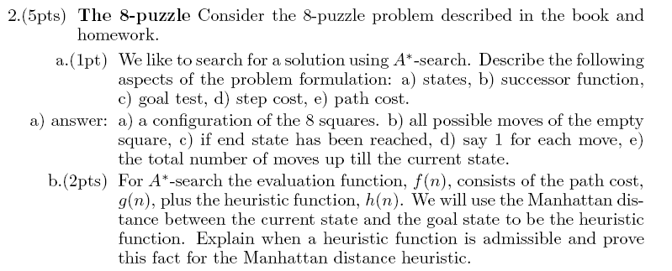


Slide 58
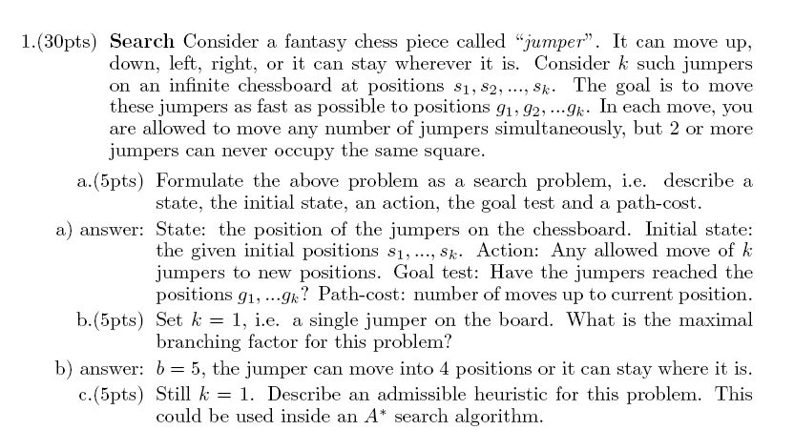
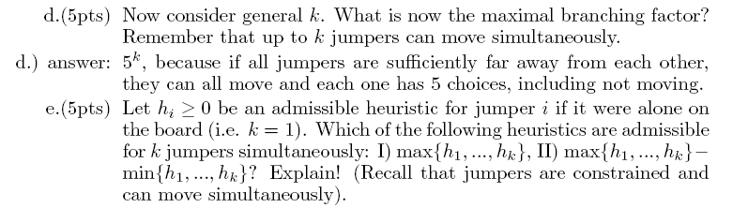


Slide 59
Appendix
Some details of the MBA* next.

Slide 60
SMA* pseudocode (not in 2nd edition 2 of book)
function SMA*(problem) returns a solution sequence
inputs: problem, a problem
static: Queue, a queue of nodes ordered by f-cost
Queue ← MAKE-QUEUE({MAKE-NODE(INITIAL-STATE[problem])})
loop do
if Queue is empty then return failure
n ← deepest least-f-cost node in Queue
if GOAL-TEST(n) then return success
s ← NEXT-SUCCESSOR(n)
if s is not a goal and is at maximum depth then
f(s) ← ∞
else
f(s) ← MAX(f(n),g(s)+h(s))
if all of n’s successors have been generated then
update n’s f-cost and those of its ancestors if necessary
if SUCCESSORS(n) all in memory then remove n from Queue
if memory is full then
delete shallowest, highest-f-cost node in Queue
remove it from its parent’s successor list
insert its parent on Queue if necessary
insert s in Queue
end

Slide 61
Simple Memory-bounded A* (SMA*)
(Example with 3-node memory)
maximal depth is 3, since
memory limit is 3. This
branch is now useless.
Progress of SMA*. Each node is labeled with its current f-cost. Values in parentheses show the value of the best forgotten descendant.
best forgotten node
Search space
best estimated solution
so far for that node
f = g+h
= goal
A
A
13[15]
0+12=12
A
A
A
10
8
12
12
13
B
G
G
10+5=15
8+5=13
13
10
10
8
16
15
B
B
G
15
13
18
H
C
D
H
I
∞
20+5=25
16+2=18
20+0=20
24+0=24
A
A
A
10
10
8
8
15[15]
15[24]
20[24]
E
F
J
K
A
8
30+5=35
30+0=30
24+0=24
24+5=29
15
B
B
G
15
20[∞]
24[∞]
B
G
I
15
24
C
25
D
24
∞
20
Algorithm can tell you when best solution found within memory constraint is optimal or not.

